Slide 1
Developing an 8-Bit Atari game Created by Yaron Nir (yaronnir2006@gmail.com)

Slide 2
Starting questions
How many developers
Leading languages
Game developers

Slide 3
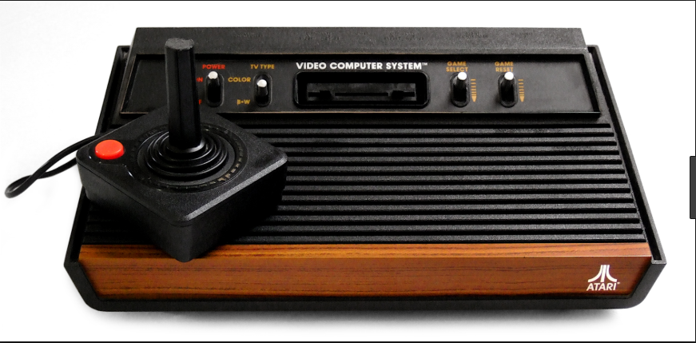
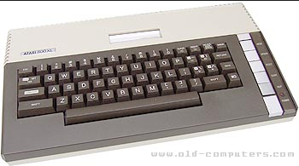
About myself
44 , married + 2 children
Teva Pharmaceutical, Technical owner , Digital Health Platform
ooVoo startup company, 13 year, last role VP R&D

Slide 4
Back in the 80s
Either Basic or Assembly (needed special cartridge)
Monthly magazines
Small collection of books
No strong debugger
No development IDE
No sound tools
No stack overflow
No internet examples
No social media
No YouTube lessons
NOTHING!

Slide 5
What do we have now?
High languages (C, Action!, Pascal, Turbo Basic and more)
Strong assembly compilers
Strong tools to create levels, characters, sprites, splash screens and much more
PC emulators such as Altirra, AtariWinPlus
Sound utilities such as RTM128
Online reference
Strong leading forums such as Atari Age
YouTube tutorials
Social Media

Slide 6
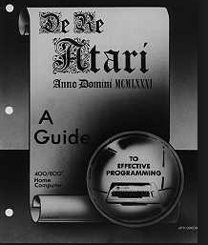
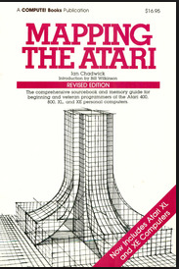
Learn The Atari Inside Out

Slide 7
Atari 8 Bit Internals
Main processor – 6502 instructions
Graphics chips – ANTIC/GTIA
POKEY chip – sound and I/O
ANTIC Display List
Graphics modes
Multi-color screens
Hi-Res
Screen Scrolling – Fine Scrolling
Hardware Sprites – 4 players, 4 missiles (5th player)
Software Sprites
Custom characters
Joystick controllers
Sound

Slide 8
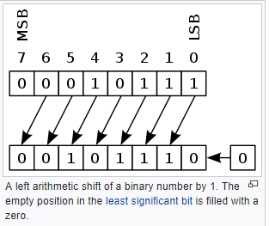
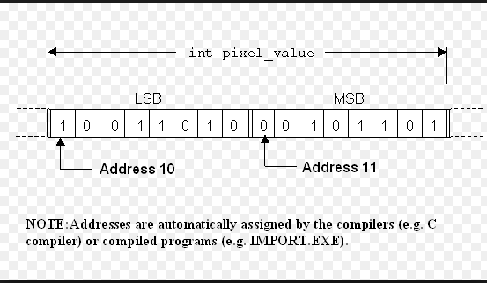
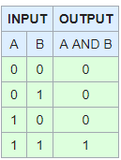
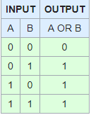
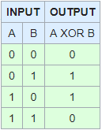
Arithmetic and Bitwise
Bit Shifting
Peek & Poke
And/Or/XOR

Slide 9
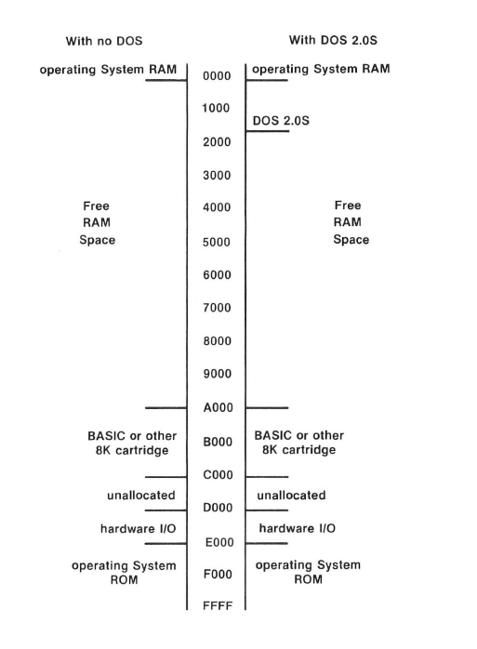
Atari Memory Layout

Slide 10
Atari Memory
$00-$FF - zero page for the operating system (don’t use)
$80-$FF - zero page to be used in your program
$100-1FF - CPU stack
$200-$2FF – OS vectors , registers (for example color registers)
$300-$3FF – OS vectors, registers
$400-$5FF – OS buffers (used for example for converting operations)
$600-$6FF – Page 6. used for object code in basic programs (don’t use)
$700 - $1FFF – Disk operating system (don’t use)
$2000-RAMTOP – our code
$8000-$9FFF – used for cartridge (8K cart / part of 16K cart)
$A000-$BFFF – used for cart (8K cart / high part of 16K cart)
$C000 - $CFFF – operating system part 1
$CC00 - $CFFF – operating system international character set
$D800 - $DFFF – FPP –(Floating point package for operating system floating point operations)
$E000 - $FFFF – operating system part 2
$E000-$E3FF – operating system default character set

Slide 11
Chip Memory Map
Each chip map holds 1 page (256 bytes) but not all of the page is used
$D000-$D0FF – GTIA chip (television interface adapter, provides pixels, colors, sprites/player missiles, console input keys, beep)
$D100- $D1FF – PBI (parallel ports, external chips that are not built in)
$D200 – $D2FF - POKEY (paddle, keyboard, serial IO and Audio)
$D300 - $D3FF – PIA (joystick, MMU memory layout, for example switching off basic or OS)
$D400 - $D4FF – ANTIC (DMA to feed GTIA with data)
$D500 - $D5FF – Module Port (R/W)
$D600-$D7FF – Reserved (for built in extensions such as VBXE(

Slide 12
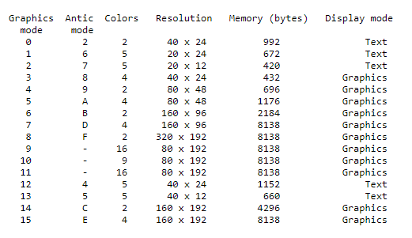
Atari Graphics

Slide 13
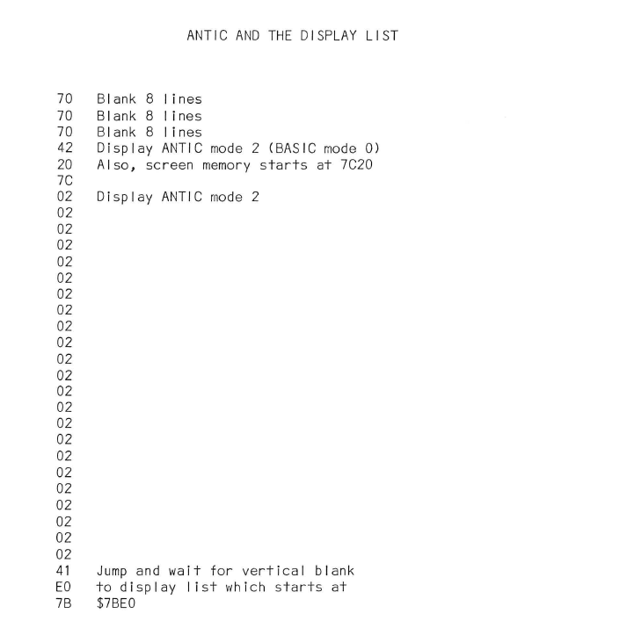
Display List

Slide 14
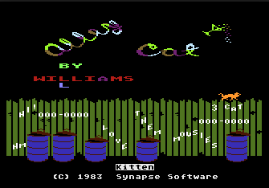

Slide 15
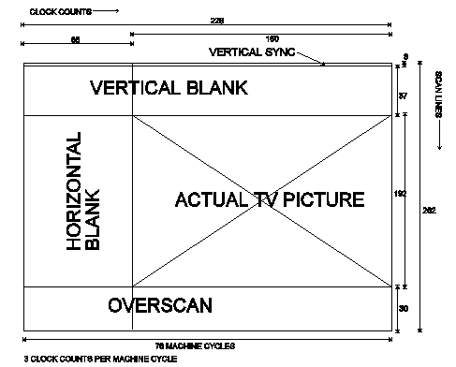
Display List Interrupt - DLI

Slide 16
VBLANK
Interrupt that occurs every 60th of a second/50th of a second NTSC/PAL respectively
You can’t disable it, system keeps calling it every time
Occurs when screen has been blanked, changes made during the interrupt will not be immediately seen on the display – a powerful advantage.
Registers A,X,Y content are placed on stack
System loops the vblank vectors

Slide 17
Immediate and deferred VBLANK
System starts with vvblki – the immediate vblank vector ($0222), this vector points to $E45F address, to understand where the OS default routine is located. OS Default routine includes the following operations:
Increment the real time clocks (12,13,14 addresses)
Color attracting (screen protected mode)
Copy shadow registers
Update values from the input controller
System then iterates to the vvblkd – the deferred vertical blank vector ($0224) , that vectors points on a simple interrupt termination at $E462
At the end of the vblank routine you must push back the registers A,X,Y values from the stack

Slide 18
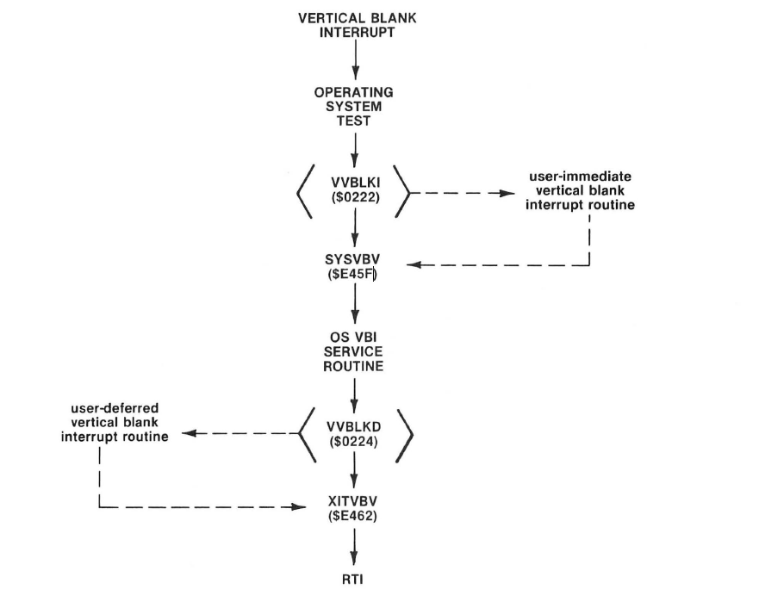
VBLANK flow

Slide 19
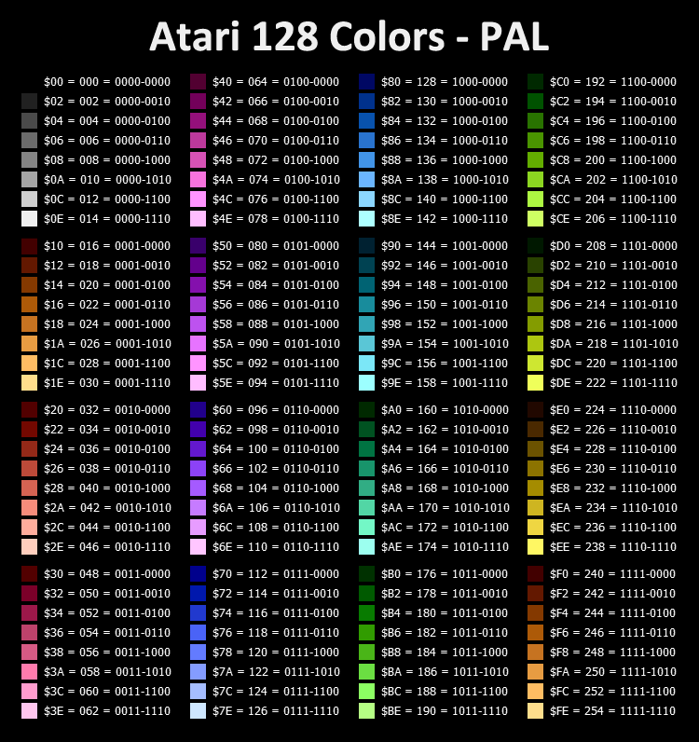
Atari Color Pallate

Slide 20
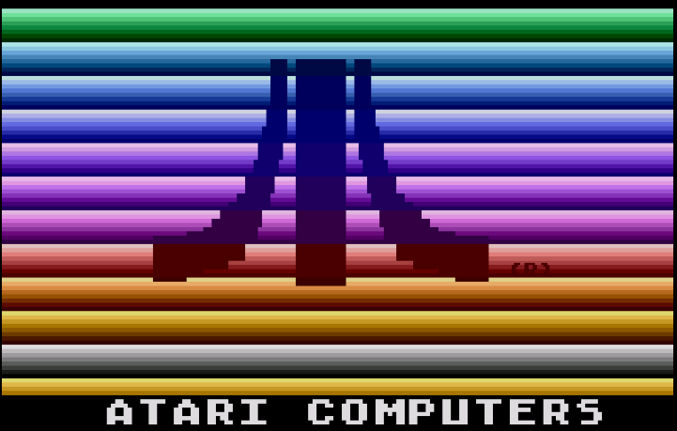

Slide 21
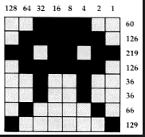
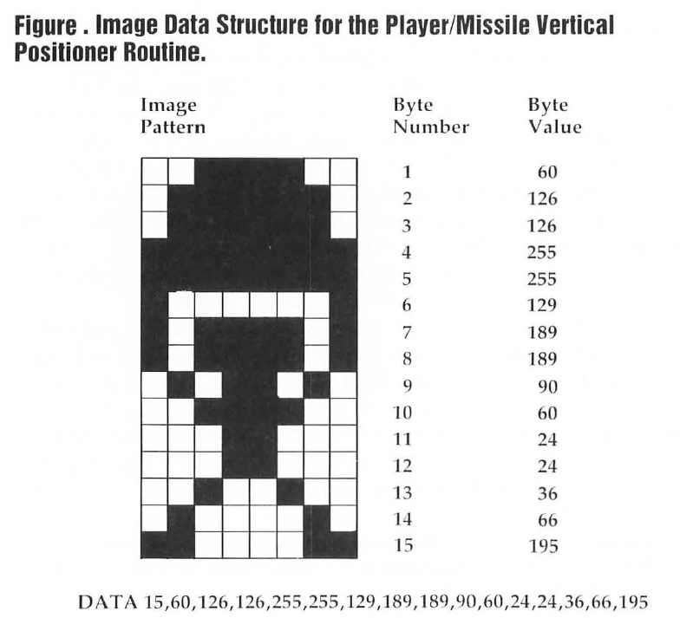
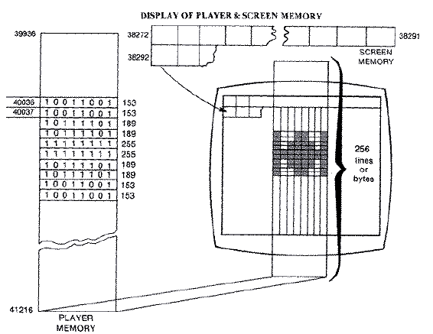
Sprites

Slide 22
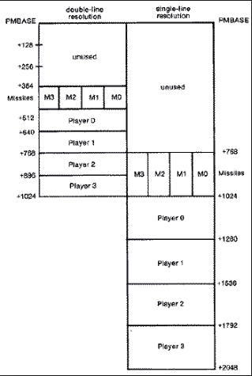
Player Missile Graphics – Hardware Sprites

Slide 23
Player Missiles Graphics
Tell ANTIC where PMBASE address is
Clear the memory of the players/missiles
Choose if you work in single line or double line resolution mode
Enable players only? Players and missiles?
What is the priority between the players and the players and the playfields
Set player colors
Set player size
Set player horizontal position
Copy the player data array into the player memory space
PMG multiplexing – change in DLI the player HPOS to have several players on screen made out of 1 player

Slide 24
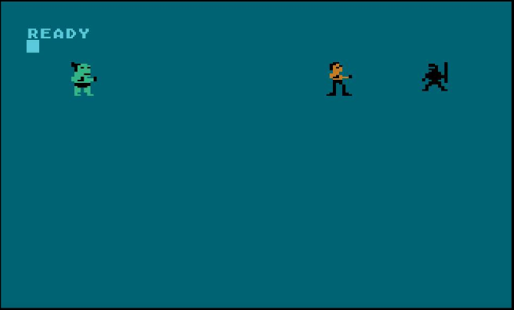
Player Missile Single Line

Slide 25
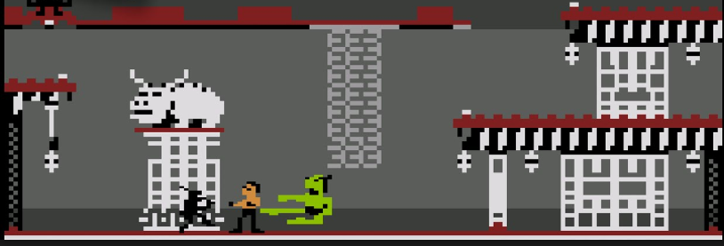
Player Missile Double Line

Slide 26
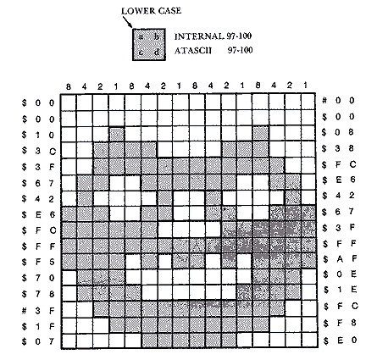
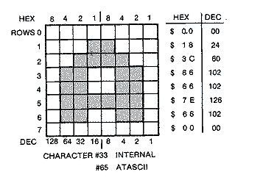
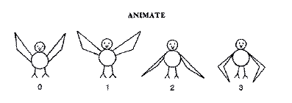
Characters Set

Slide 27
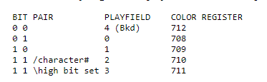
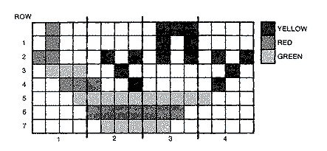
Multicolor Character Set

Slide 28
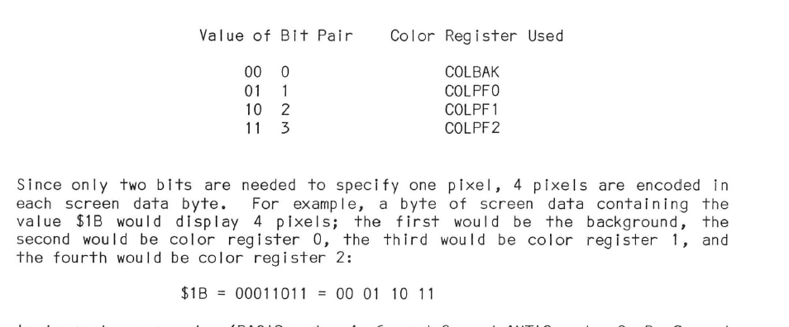
Multicolor Character Set – Continue

Slide 29
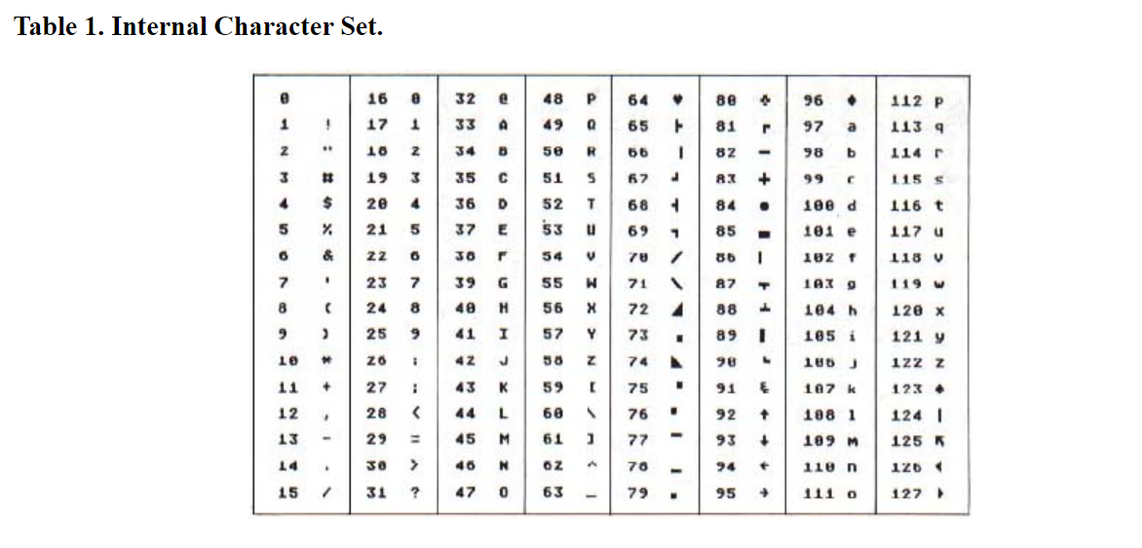
Atari ACSII - ATASCII

Slide 30
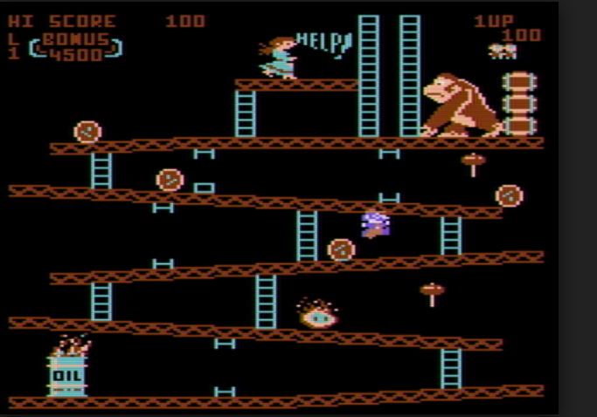
Game screen

Slide 31
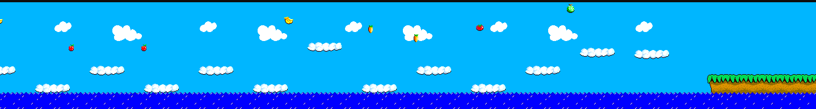
Game Screen

Slide 32
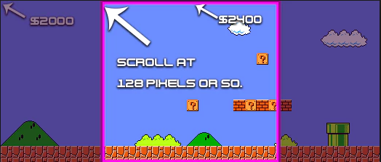
Screen Scrolling

Slide 33
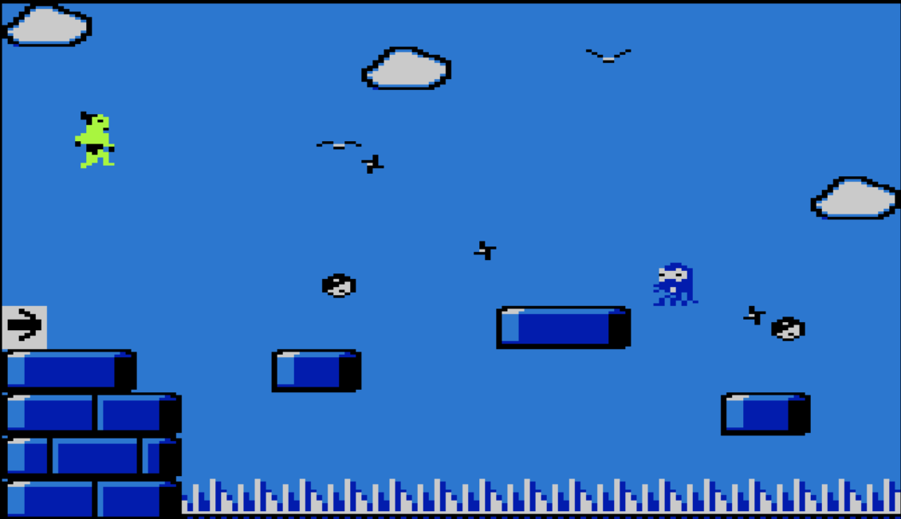
Everything happens in the main loop

Slide 34
Where do I start?

Slide 35
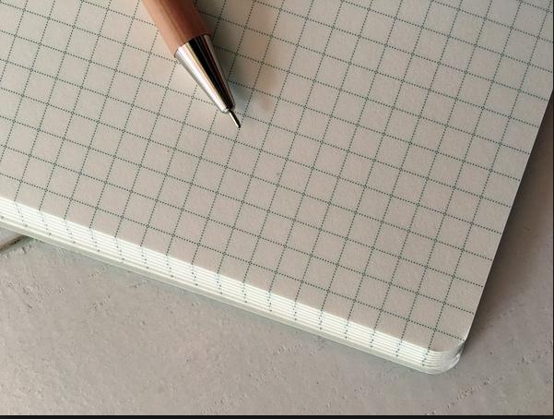
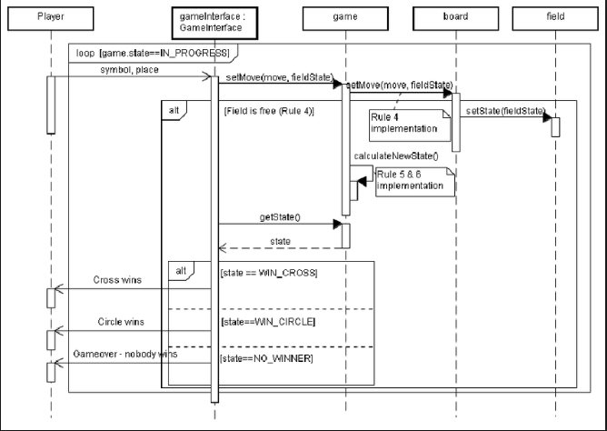
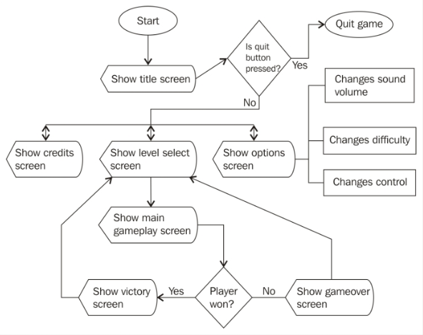

Slide 36
IDE used for development

Slide 37
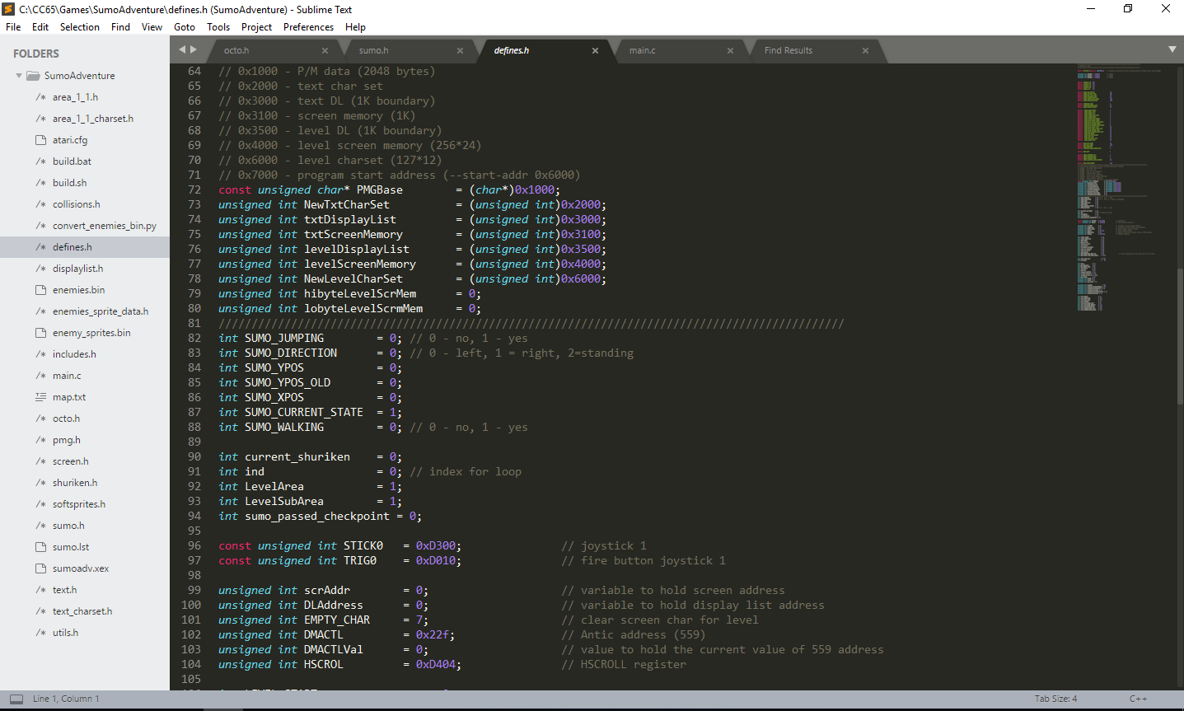

Slide 38
Emulators for Atari

Slide 39
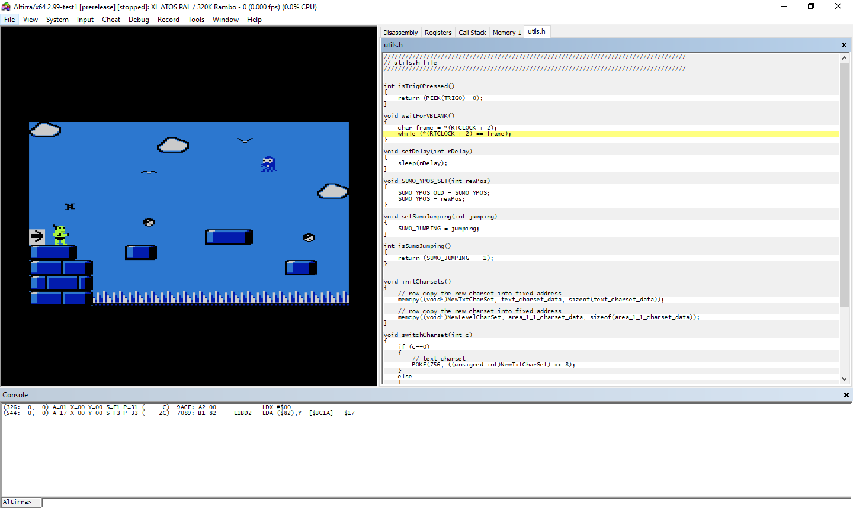

Slide 40
Tools to build custom character set

Slide 41
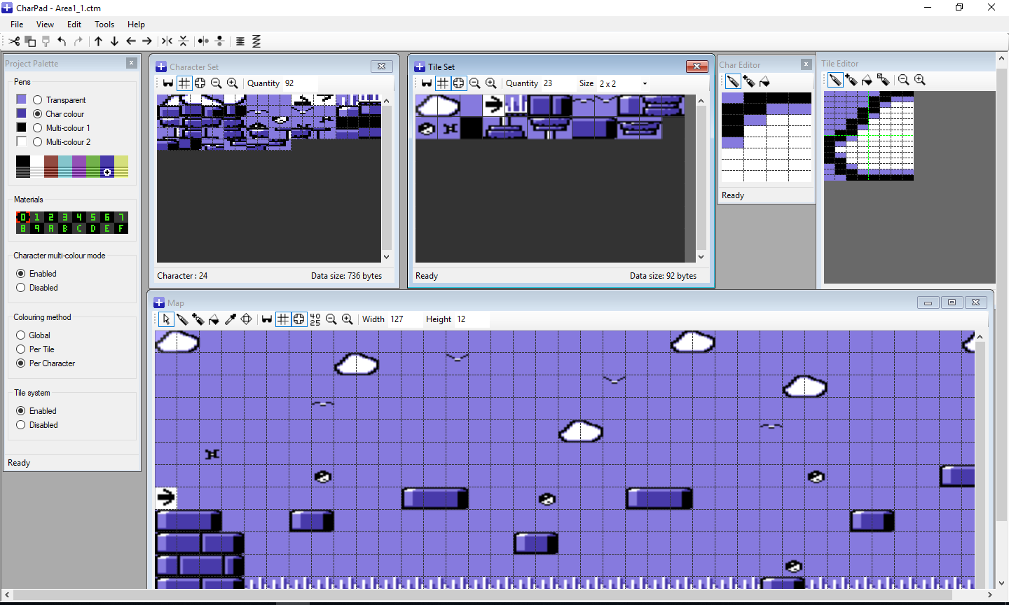

Slide 42
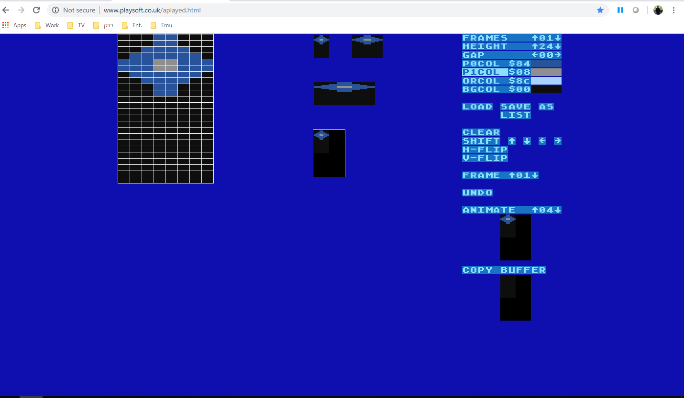
Sprite Editor http://www.playsoft.co.uk/aplayed.html

Slide 43
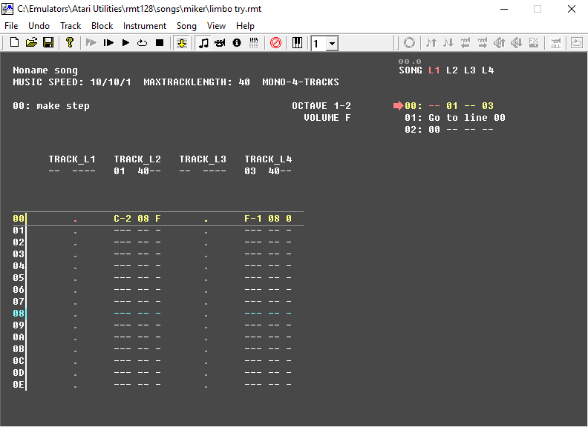
Sound Utility - RASTER Music Tracker
RMT 128

Slide 44
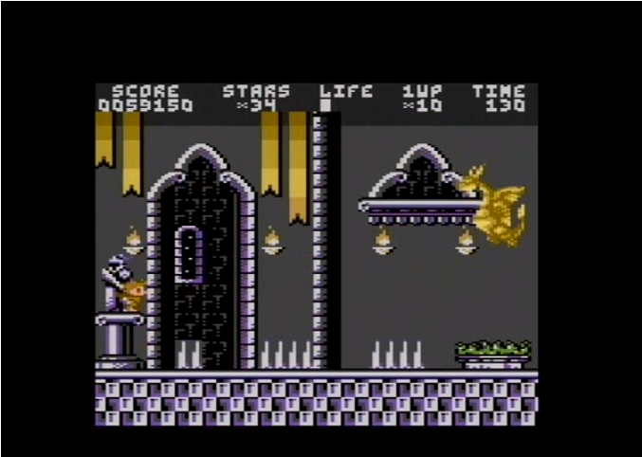
Homebrew Games
Crown Land

Slide 45
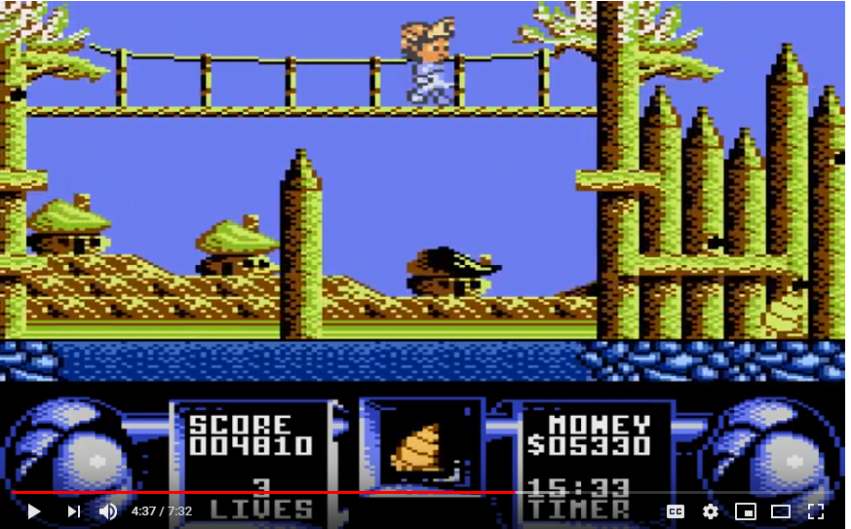
Homebrew Games
Flimbo’s Quest

Slide 46
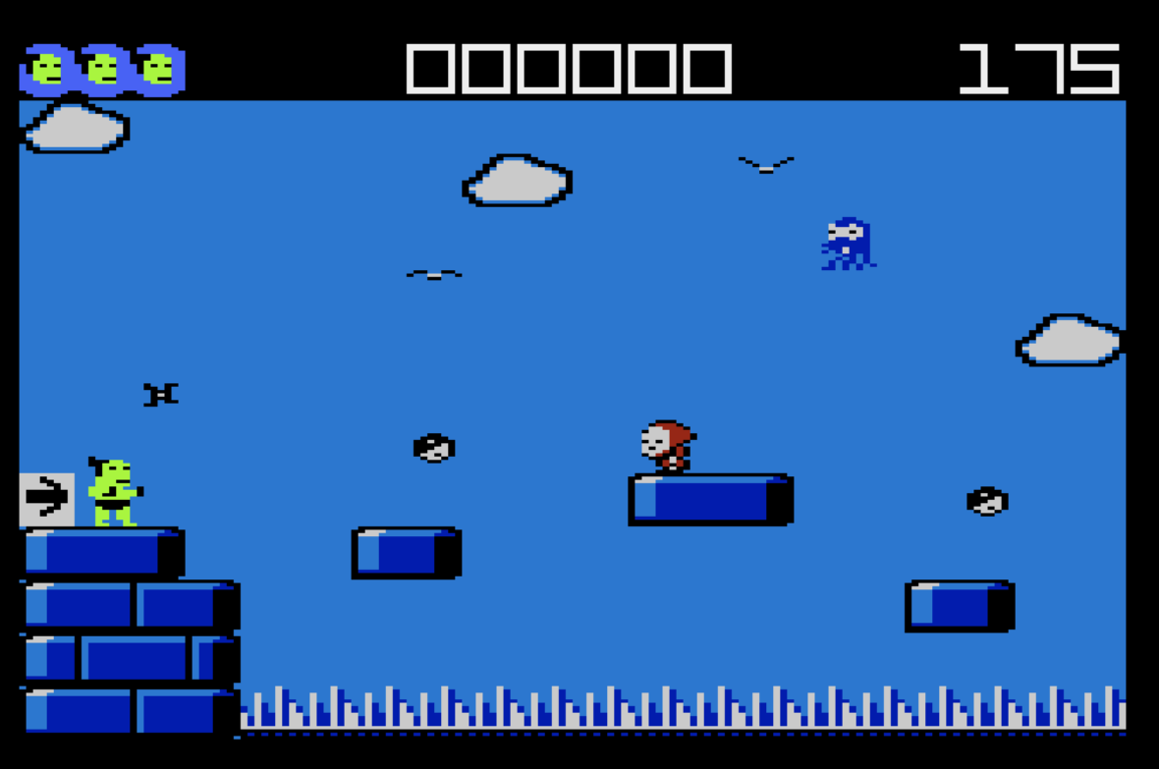
W.I.P – Sumo Adventure

Slide 47
https://www.youtube.com/watch?v=C1XJwG0FFso

Slide 48
Thank You!

